Slide 1
Predicting Obesity Analysis of Data collected from Mexico, Peru, and Colombia Maryi Tatiana Palacios 2025

Slide 2
Description of the Dataset
This dataset was collected through an online survey of people from Mexico, Peru, and Colombia, aged between 14 and 61 years. The dataset was collected with the goal of predicting obesity levels based on factors like eating habits and physical conditions.
Number of records: 2,111 records Number of variables: 17 variables
Dataset Link: https://archive.ics.uci.edu/dataset/544/estimation+of+obesity+levels+based+on+eating+habits+and+physical+condition

Slide 3
Variables
Variable | Description | Type | Relevance
Gender | Gender | Nominal | Moderate
Age | Age | Continuous | High
Height | Height | Continuous | Moderate
Weight | Weight | Continuous | High
family_history_with_overweight | Has a family member suffered or suffers from overweight? | Binary | Low
FAVC | Do you eat high caloric food frequently? | Binary | High
FCVC | Do you usually eat vegetables in your meals? | Discrete | Moderate
NCP | How many main meals do you have daily? | Continuous | High
CAEC | Do you eat any food between meals? | Nominal | Moderate
SMOKE | Do you smoke? | Binary | High
CH2O | How much water do you drink daily? | Continuous | High
SCC | Do you monitor the calories you eat daily? | Binary | High
FAF | How often do you have physical activity? | Continuous | High
TUE | How much time do you use technological devices such as cell phone, videogames, television, computer and others? | Discrete | Low
CALC | How often do you drink alcohol? | Nominal | Moderate
MTRANS | Which transportation do you usually use? | Nominal | Low
NObeyesdad | Obesity level | Nominal | High

Slide 4
Problem: Predicting Obesity Levels
The objective is to predict the obesity level of individuals, categorizing them into one of seven levels: Insufficient Weight, Normal Weight, Overweight Level I, Overweight Level II, Obesity Type I, Obesity Type II, and Obesity Type III; based on factors such as eating habits and physical conditions.

Slide 5
Machine Learning System
Evaluation
Cleaning
Model selection
Training
Input Data
Prediction
Output

Slide 6
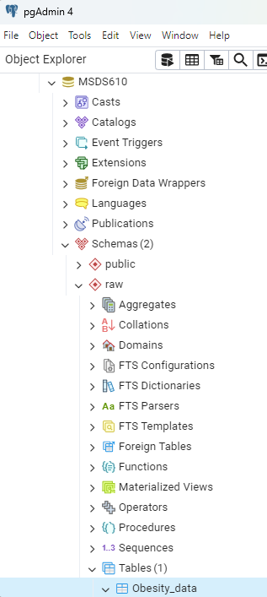
Screenshot - pgAdmin Data

Slide 7
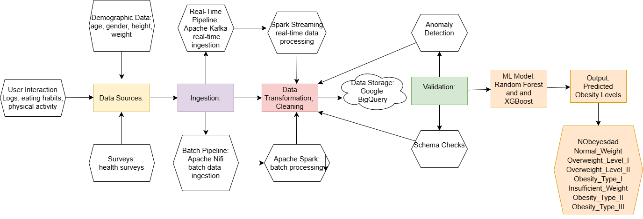
Data Pipeline

Slide 8
Pipeline Type: (batch + streaming)
I chose a combined pipeline (batch + streaming) because this approach allows me processing both historical data and real time updates.
Data Format: (batch + streaming)
I chose Parquet for storing the processed data because it’s a columnar format, ideal for large datasets, and works great with tools like Apache Spark and Google BigQuery, which I plan to use.

Slide 9
Data Quality Issues
I identified 24 duplicate records and decided to drop them.
I decided to replace 'no' with 'Never' since it makes more sense with the question
Absence of a 'demographic' variable (such as country or city) for a better analysis of obesity levels by region.

Slide 10
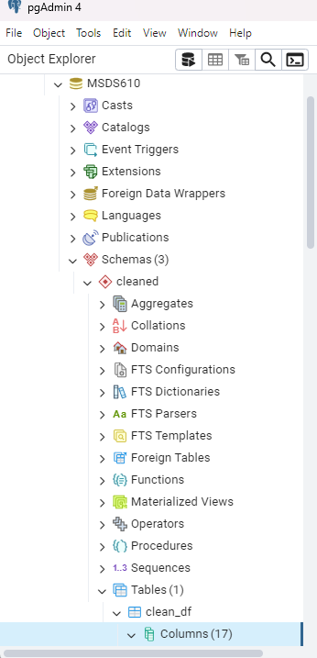
Screenshot

Slide 11

Thank you

